Slide 1
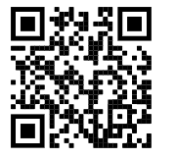
25 Components needed for composite fabrication
Creation of a 4x8 Panel
42 Component pieces provided by suppliers
Composite Fabrication
Sanding, CNC
Graphics and Clear Coat
Creation of paddle head
Assembly
17 Components needed for Assembly
Low Hanging Fruit:
Serial /Warranty Number is added to each paddle effortlessly via QR scan
Quality Check
Finished Good Inventory and Ready to Ship
Example Paddle Manufacturing Process Improvement Project using cloud QR app
Low Hanging Fruit: Customer can scan QR code to auto-populate warranty form
Future Facing Capability:
Customer Engagement via QR
Reorder-point Shopify automation
Low Hanging Fruit:
Production Tracking and Data Validation via Warranty and Serial IDs
Improvement Implemented
QR Demo Link: qr-app-test.azurewebsites.net

Slide 2
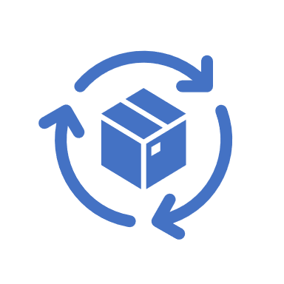


Possible Key Benefits and System Capabilities
Seamless Technology Integration
Optimized Information Flow
Stellar Customer Experience
Cost Savings on Quality Improvement
Best in class cloud database and hosting for $5 a month.
Scalable to future processes
Auto-population on app from databases
Live data links
Shopify/order process integration
Industry Standard component and inventory modules
Easy onboarding of new bill of materials
Component and Inventory buffering based on demand
QR customer engagement
QR warranty auto population
Paddle information via QR Scan
Enables Fulfillment and production at Scale
Production Tracking and defect isolation tagging
Error-proofing and data validation

